Slide 1

RUNGTA COLLEGE OF DENTAL SCIENCES AND RESEARCH
Direct filling gold
DEPARTMENT OF CONSERVATIVE DENTISTRY AND ENDODONTICS

Slide 2
Specific learning Objectives
Core areas* | Domain ** | Category #
Classification | Cognitive | Must know
Indications | Cognitive | Must know
Contraindications | Cognitive | Must know
Heat treatment of Gold | Psychomotor | Must know
Cavity Preparation for DFG | Psychomotor | Must know

Slide 3
Contents
Introduction
History
Classification
Characteristics of Gold.
Factors influencing Selection of Gold.
Uses of Gold.
Forms of Direct Filling Gold.
Indications of Direct Filling Gold.
Contraindications of Direct Filling Gold.
Advantages of Direct Filling Gold.
Disadvantages of Direct Filling Gold.
Heat treatment of Gold
Condensation or Compaction.
Biocompatibility of Gold Restorations.
Cavity Preparation for DFG

Slide 4
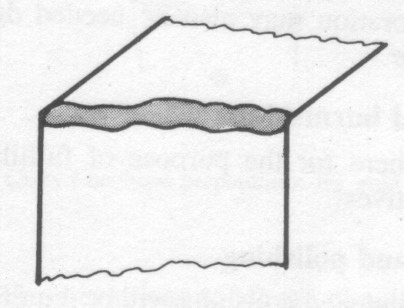
General Steps for Insertion of Direct Gold Restoration in a Cavity Preparation
The following can serve as a general outline for the procedure of inserting direct gold materials into a cavity preparation:
A. Three step build-up for the restoration
1. "Tie formation"
This involves connecting two opposing point angles or starting points filled with gold with a transverse bar of gold. Such a "tie" forms the foundation for any restoration in direct gold.
Resistance to displacement should be tested before proceeding to the next step.

Slide 5


2. "Banking of walls"
This is accomplished by covering each wall from its floor or axial wall to the cavosurface margin with the direct gold material. A wall should be banked in a way that will not obstruct tie formation or banking of other walls in the cavity preparation.
"Banking" should be performed simultaneously on the surrounding walls of the preparation.
3. Shoulder formation
Sometimes, to complete a build-up, it is necessary to connect two opposing walls with the direct gold material.
These three steps should completely fill up the cavity preparation, but the build-up should continue until the preparation is overfilled.

Slide 6
B. "Paving" of the restoration
Every area of cavosurface margin portion should be individually covered with excess cohesive gold foil
“Foot" condenser is useful.
C. Surface hardening of the restoration
Instrument is moved all over the surface of the restoration in one direction to strain harden the surface gold and fulfill the rest of the objectives of condensation.

Slide 7
D. Burnishing
Done with proper instruments from gold to tooth surface.
Creates a solid gold sheet marginally.
Enhance surface hardening.
Adapt the material more to the margins.
Eliminates surface and marginal voids.
E. Margination
Knives and files are used from gold surface to the tooth surface.
Small increments should be removed at a time
Do not try to remove more material at a time as it may cause displacement of the whole restoration.
Done to visualize original outline of the cavity.

Slide 8
F. Burnishing
Follows margination to close marginal discrepancy.
Strain harden the surface.
G. Contouring
Create the proper anatomy of restoration that coincide the tooth.
Accomplished using knives, files and finishing burs.
If contouring involves margin they should be reburnished before final contouring.
H. Additional burnishing
I. Finishing and polishing
Precipitated chalk, tin oxide on soft bristle brushes are used.
J. Final burnishing
This is done to ensure closure of marginal voids and other surface discrepancies.

Slide 9
BIOCOMPATIBILITY OF GOLD RESTORATION
It causes irritation to pulp dentin organ.
Factors:
  Condensation energy.
  Thermal energy.
  Frictional heat of finishing and polishing.
  Galvanic current.

Slide 10
Effect of direct gold restoration at different effective depth
  With an effective depth of 3 to 3½ mm a normal pulp will undergo a healthy reparative reaction.
  Less than 1mm there will be destruction of pulp dentin organ. Initial sign is cracking of pulpal or axial wall.

Slide 11
Protective bases necessary for pulp dentin organ:
  Effective depth 3 to 3 ½ - healthy reparative reaction.
  <1mm – destruction in the pulp dentin organ.
  3mm or more – no intermediary base required.
  2mm or more – cavity varnish applied on walls and floors.
  1-2mm – subbase of calcium hydroxide or ZOE indicated.

Slide 12
The decline of gold restorations:
Patient factor.
Operator factor.
Material factor.

Slide 13
Patient factor:
  High cost
  Discomfort.
  Necessity for extra visits.
  Esthetics.
  Galvanic pain.
  Allergy.

Slide 14
Operator factors:
  Necessity for higher skill.
  Lure of cosmetic dentistry.
  Need for more chairside time.
  Possible pulpal and periodontal damage.
  Possible damage to enamel margins.
  Extra care during degassing.

Slide 15
Material factor:
  Economy.
  Non-availability.
  High thermal conductivity.
  Possible galvanic effect.
  High density of gold alloys.
  Softness of pure gold.
  Colour of gold.
  Evolution of newer materials.

Slide 16
CAVITY PREPARATION FOR DIRECT FILLING GOLD

Slide 17
CLASS I TOOTH PREPARATION FOR DFG
The external walls of the preparation are parallel to each other.
In extensive preparations,mesial or distal or both may diverge slightly occlusally.
The pulpal floor is of uniform depth,parallel with the plane of the surface treated & 0.5mm into dentin.
Undercuts may be placed facially and lingually if additional retentive features are required.
A slight cavosurface bevel may be placed to
  Create a 30-40 deg metal margin for ease in finishing
  Remove remaining rough enamel
Bevel is not greater than 0.2mm in width and placed with a white rotary stone or suitable finishing bur.

Slide 18
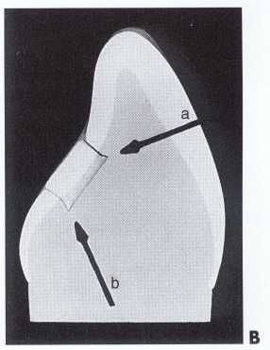
A. Typical Class I occlusal marginal outlines for pit restorations with direct gold.
B. Cross-section of model of lingual Class I preparation on maxillary incisor. Undercuts (a and b)
are placed in dentin incisally and gingivally for additional retention

Slide 19
CLASS V TOOTH PREPARATION FOR DFG
Outline form is trapezoidal in shape.
The occlusal margin is straight which improves esthetic.
The gingival outline is shorter than occlusal and parallel to occlusal margin for easy identification in finishing phases.
The mesial and distal margins are straight lines that meet the occlusal margin in sharp obtuse angle,both of which complete the trapezoidal form.
The axial wall is approx. 1mm deep in the occlusal half of the preparation.
At cervical region,depth may decrease from 1 to 0.75mm.

Slide 20
The axial wall must be in dentin and occluslogingivally it should be flat and parallel with the facial surface of tooth.
A subaxial wall may be created within the axial wall to remove infected caries that has progressed deeper.
Occlusoaxial internal line angle is a sharp right angle.
Gingivoaxial line angle is a sharp acute angle
Mesio and distoaxial line angles are sharp obtuse angles
The occlusal and gingival walls are facially convergent which provides retention
The orientation of gingival wall is the key to the retention form. It is straight mesiodistally,meeting the mesial and distal walls in sharp line angles

Slide 21
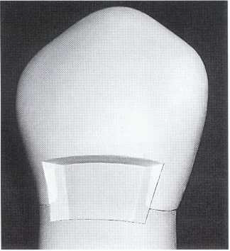
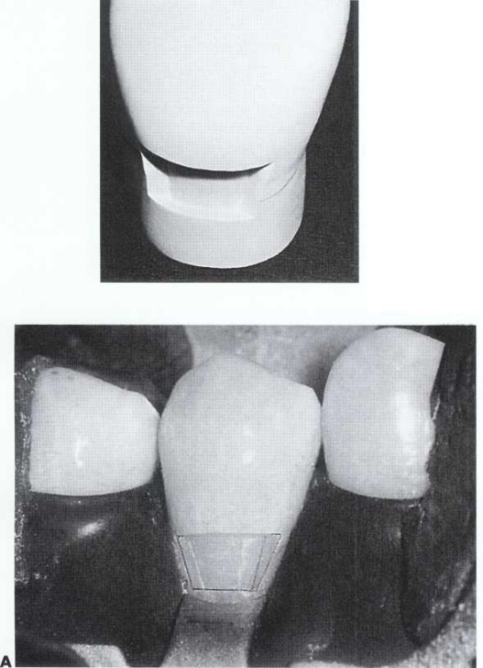
Facial view of Class V tooth preparation for direct gold. Occlusal and gingival margins are straight, parallel with each other, and extend mesially and distally to respective
mesiofacial and distofacial tooth crown line angles. Mesial and distal walls diverge facially and form obtuse angles with axial wall. Line angles and point angles are sharp.
Facioocclusal view of design of gingival wall in Class V preparation for direct gold.Axiogingival line angle is acute and was prepared at expense of gingival wall. This gingival margin is on cementum. If on enamel, the gingival cavosurface would be beveled slightly

Slide 22
CLASS III TOOTH PREPARATION FOR DFG
The marginal outline is most important.
From a facial view,the gingival four fifths of the facial margin is straight and parallel with the contour of the tooth.
The facial margin forms a gentle curve in its incisal one fifth to blend with the incisal margin.
The gingival margin is crucial. Its faciolingual length dictates the remainder of the preparation.
It is straight faciolingually and approx.at a right angle to the long axis of the tooth.
It meets the facial margin in sharply defined obtuse angle and the lingual margin in acute angle.
Incisal margin is placed incisally to the contact area to provide access.

Slide 23
Axial wall is flat faciolingually and incisogingivally and established 0.5mm into the dentin.
Convenience form is made by the abrupt incisolingual curve by adequate clearance of all margins from the adjacent tooth and by placement of sharp internal point angles.
The finishing of enamel walls require placement of a facial, incisal and lingual cavosurface bevel which determines the final marginal outline.

Slide 24
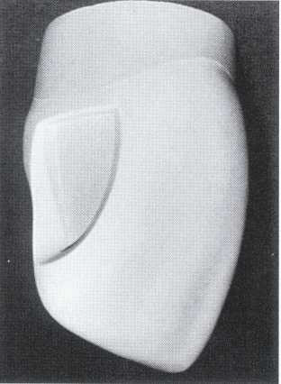
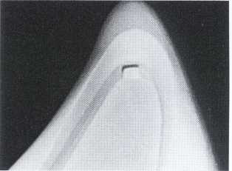
View of incisal retention in Class III preparation.
Undercut is placed in dentin but does not undermine enamel.
Proximofacial view of Class III preparation

Slide 25
MODIFICATIONS OF CLASS III PREPARATION
The distal surface of maxillary canines may require a modification.
Because of highly convex surface it is desirable to create a “straight line preparation” in which the facial outline appears as a slice.
This provides considerable convenience form on gingival wall
Also appropriate for distal surface of highly contoured lateral incisors.

Slide 26
The mandibular incisors require a modified class III preparation because lingual access may be difficult.
The lingual wall is created in one plane and extension of lingual and incisal walls is limited.
Incisal extension is restricted because the proximal contact area between mandibular incisors is often near the incisal edge.
Incisal retentive angle for mandibular class III preparation is placed directly incisally rather than faciolingually as in maxillary.
Lingual approach may be made using E-Z gold.
In such cases , the lingual slot type of preparation is made with rounded angles.

Slide 27
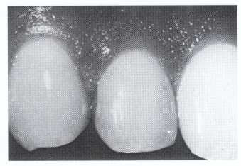
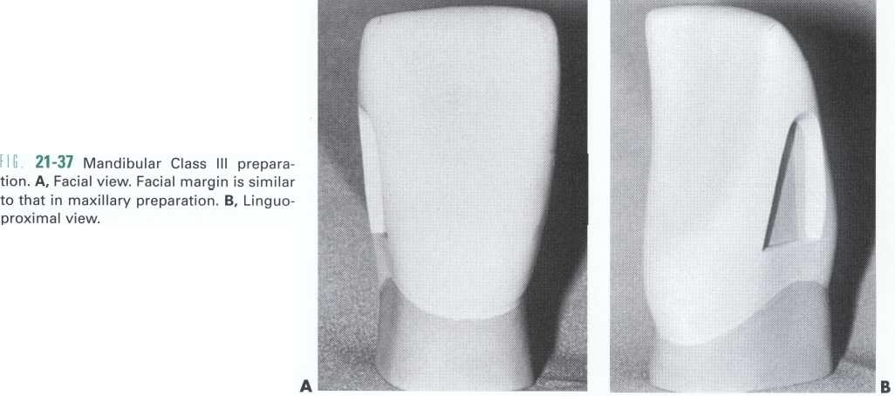
Direct gold restoration of a clinical Class III preparation of straight line design on distal portion of maxillary lateral incisor.

Slide 28
Conclusion
No metal or combination of metals serve dentistry so well and in a wide range of application as does the gold and its several types. Without gold as a restorative material the practice of dentistry would be changed significantly as no other material serves as its complete satisfactory substitute.
So as a clinician it is our duty to have a good knowledge and idea about its manipulation and cavity preparation.

Slide 29
TAKE HOME MESSAGE
The marginal outline is most important.
From a facial view,the gingival four fifths of the facial margin is straight and parallel with the contour of the tooth.
The facial margin forms a gentle curve in its incisal one fifth to blend with the incisal margin.
The gingival margin is crucial. Its faciolingual length dictates the remainder of the preparation.
It is straight faciolingually and approx.at a right angle to the long axis of the tooth.
It meets the facial margin in sharply defined obtuse angle and the lingual margin in acute angle.
Incisal margin is placed incisally to the contact area to provide access

Slide 30
questions
Forms of DFG
Mat gold
Importance and methods of annealing
Steps in compaction of DFG in a cavity
Finishing and polishing of DFG

Slide 31
REFERENCES
Science Of Dental Materials -----9th Edition By Skinners.
Art And Science Of Operative Dentistry -4th Edition-Studervant
Operative Dentistry 2nd Edition By Summit, Robbins ,Schwarts .
Restorative Dentals Materials 11th Edition By Craig.
Packard’s Manual Of Operative Dentistry 8th Edition E.A.M.Kidd, G.N. Smith, T.N.Watson.
Operative Dentistry Edition, By Marzouk .

Slide 32
Suggested reading
Science Of Dental Materials -----By ANUSAVICE, Skinners.
Art And Science Of Operative Dentistry -4th Edition-Studervant
Restorative Dentals Materials 11th Edition By Craig.

Slide 33


